Slide 1
The Mystical Wanderers
Tittle – Smart Menu Card

Slide 2
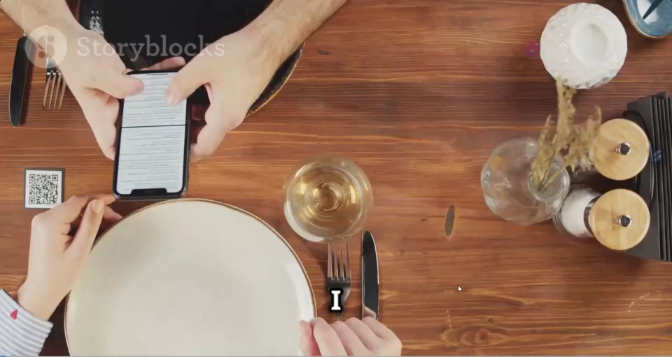

Slide 3
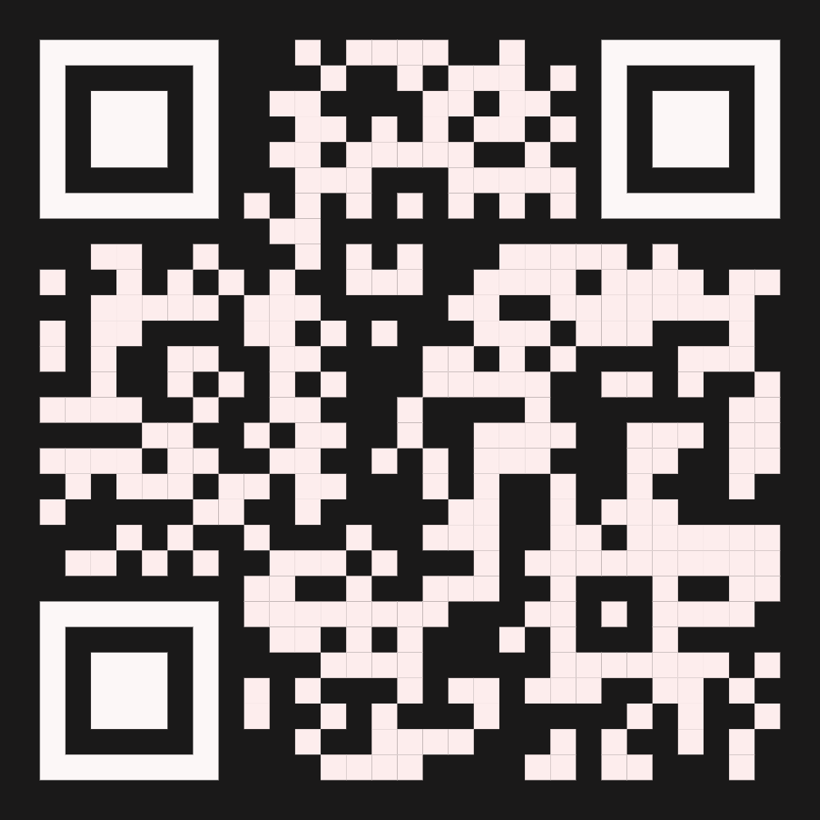
Scan Me

Slide 4
Thank you

